Slide 1
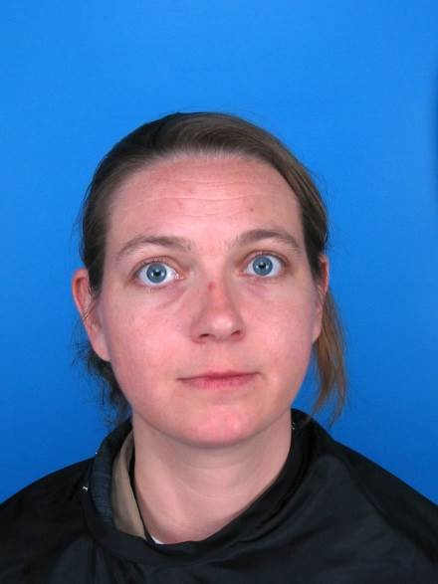
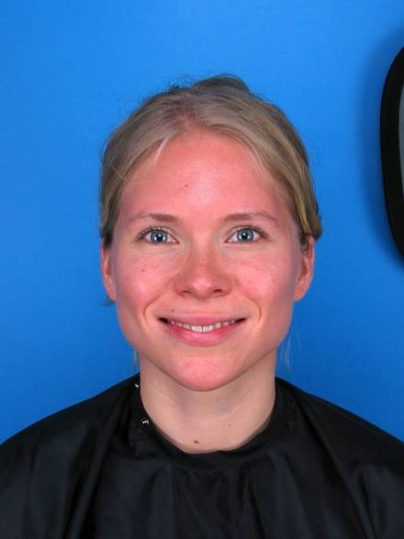



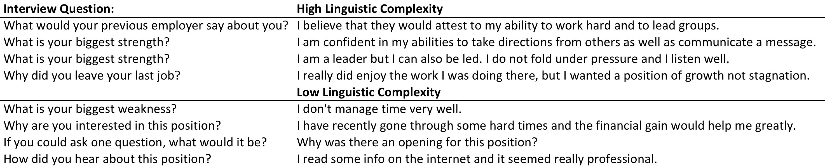
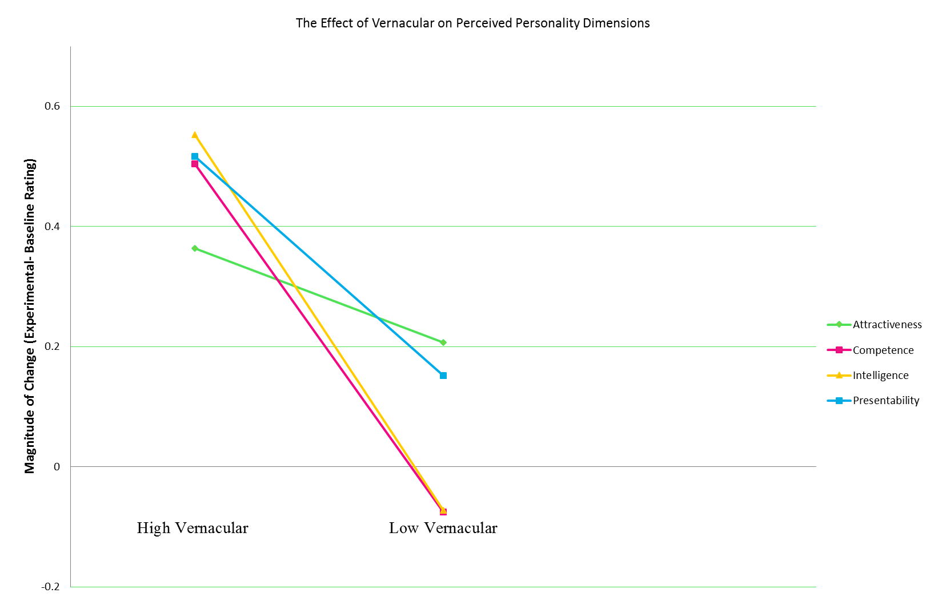
The Effect of Linguistic Expression on Impression Formation
David Brocker, Michaela Porubanova
Farmingdale State College
INTRODUCTION)
METHOD
RESULTS
DISCUSSION
Past research has shown that abstract language makes speakers seem more powerful and are perceived as being ‘warmer’.
  Wakslak, Han & Smith 2014
Other findings show that perceived intelligence is associated with measured intelligence in men but not women.
  Kleisner Chvátalová, Flegr 2014
Attractiveness can also influence perceived quality, clarity, and helpfulness of college instructors
  Raacke & Raacke, 2007
Judgments of attractiveness may be biased by a raters own attributes.
  Sim, Saperia, Brown & Bernieri 2015
Stimuli: Psychological Image Collection at Sterling (pics.stir.ac.uk)
  60 Photos (20 Female and 40 Male)
This research consisted of three parts:
  A Baseline condition: initial measure of perceived attractiveness, perceived competence, perceived presentability, and perceived intelligence of individuals depicted in photos.
  A separate test to establish linguistic proficiency of the statements.
  Experimental condition: A synthesis of the above two tests to make the experimental condition of alternating high and low linguistic proficiency statements with random faces.
We found significant correlation between Perceived Intelligence and Perceived Attractiveness
Attractiveness further positively correlated with Perceived Competence (r=.32, p< .001) and Perceived Presentability (r=.60, p< .001).
Perceived Attractiveness also positively correlates with likelihood of being hired, r=.39, p< .001.
These results indicate that linguistic proficiency affects person perception such as their perceived competence, perceived intelligence, perceived presentability, and perceived attractiveness, respectively.
It is interesting to note that out of all four dimensions, linguistic proficiency had the smallest effect on perceived attractiveness. The two dimensions that were affected most by linguistic proficiency were those of perceived competence and perceived intelligence.
RESULTS
We found a main effect of vernacular on perceived attractiveness. F (1, 809)= 9.02, p<0.01, η²=.01.
    M (high vernacular)=0.36, SE= .04, M (low vernacular)=0.21, SE= .06
We found a main effect of vernacular on perceived competence. F (1, 809)= 30.94, p<0.001, η²= .11.
    M (high vernacular)=0.50, SE= .05, M (low vernacular)= -.08, SE= .05
We found a main effect of vernacular on perceived intelligence. F (1, 809)= 41.30, p<0.001, η² =.05.
    Means: M (high vernacular)=0.53, SE= .05, M (low vernacular)= -.07, SE= .05
We found a main effect of vernacular on perceived presentability F (1, 809)= 34.03, p<0.001, η² =.04.
    M (high vernacular)=0.52, SE= .052, M (low vernacular)=0.15, SE= .05
FUTURE DIRECTION
Design
Is there a temporal aspect to people perception? The participants experienced a two week gap in-between baseline and experimental conditions. The participants were aware they were viewing the same pictures yet they rated them differently. Is there a time span in which this effect works or can it be immediate?
Would the presence of an audio sample provide enough information for a participant to rate the speaker on all four discussed personality dimensions? If so, could there possibly be a prevalence of gender bias taking place?
Purpose
Participants were first asked to rate images on a seven point likert scale for the dimensions of: competence, attractiveness, presentability and intelligence.
After two weeks they were asked to rate the same photos but this time they would be accompanied by either a statement of high or low linguistic complexity.
Testing if linguistic proficiency influences perceived intelligence, competence, attractiveness, and presentability.
Hypotheses:
  Individuals would receive higher ratings on attractiveness when presented with a statement of high linguistic complexity compared to a statement of low linguistic complexity
  Individuals would also be rated higher on competence, presentability and intelligence when presented with a statement of high linguistic complexity compared to a statement of lower linguistic
REFERENCES
Bonds-Raacke, J., & Raacke, J. D. (2007). The relationship between physical attractiveness of professors and students’ ratings of professor quality. Journal of Psychiatry, Psychology and Mental Health, 1(2), 1-7.
Kleisner K, Chvátalová V, Flegr J (2014) Perceived Intelligence Is Associated with Measured Intelligence in Men but Not Women. PLoS ONE 9(3): e81237.doi: 10.1371/journal.pone.0081237
Sim, S. Y. L., Saperia, J., Brown, J. A., & Bernieri, F. J. (2015). Judging attractiveness: Biases due to raters’ own attractiveness and intelligence. Cogent Psychology, 2(1).
Wakslak, C. J., Smith, P. K., & Han, A. (2014). Using abstract language signals power. Journal of personality and social psychology, 107(1), 41.
CONTACT
David Brocker
brocda@farmingdale.edu

